Slide 1


Capstone Project - 3 CARDIOVASCULAR RISK PREDICTION MACHINE LEARNING(CLASSIFICATION)
BY MD AMANATULLAH (Data Science Trainee) ALMABETTER

Slide 2
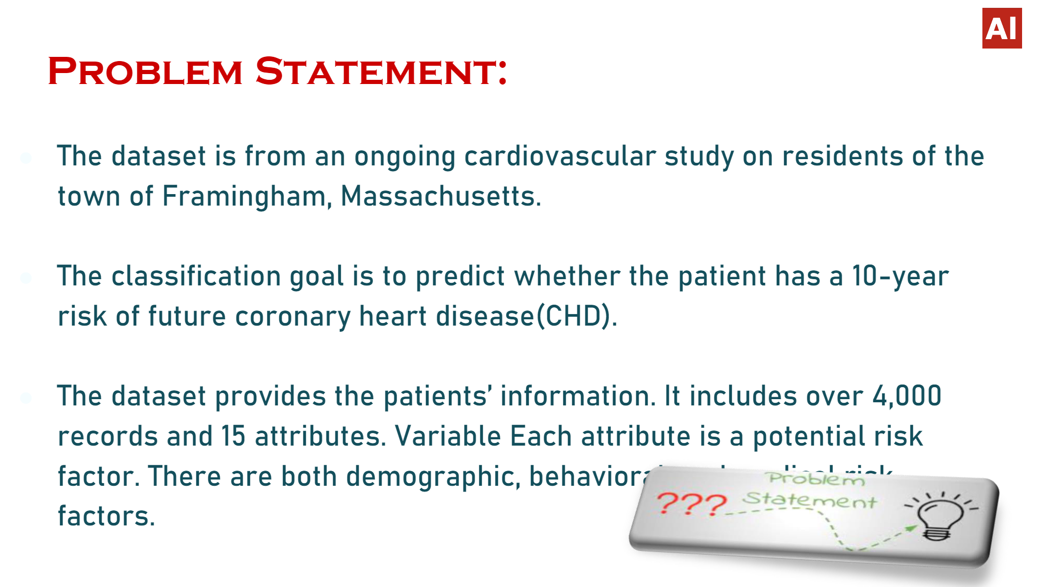

Slide 3
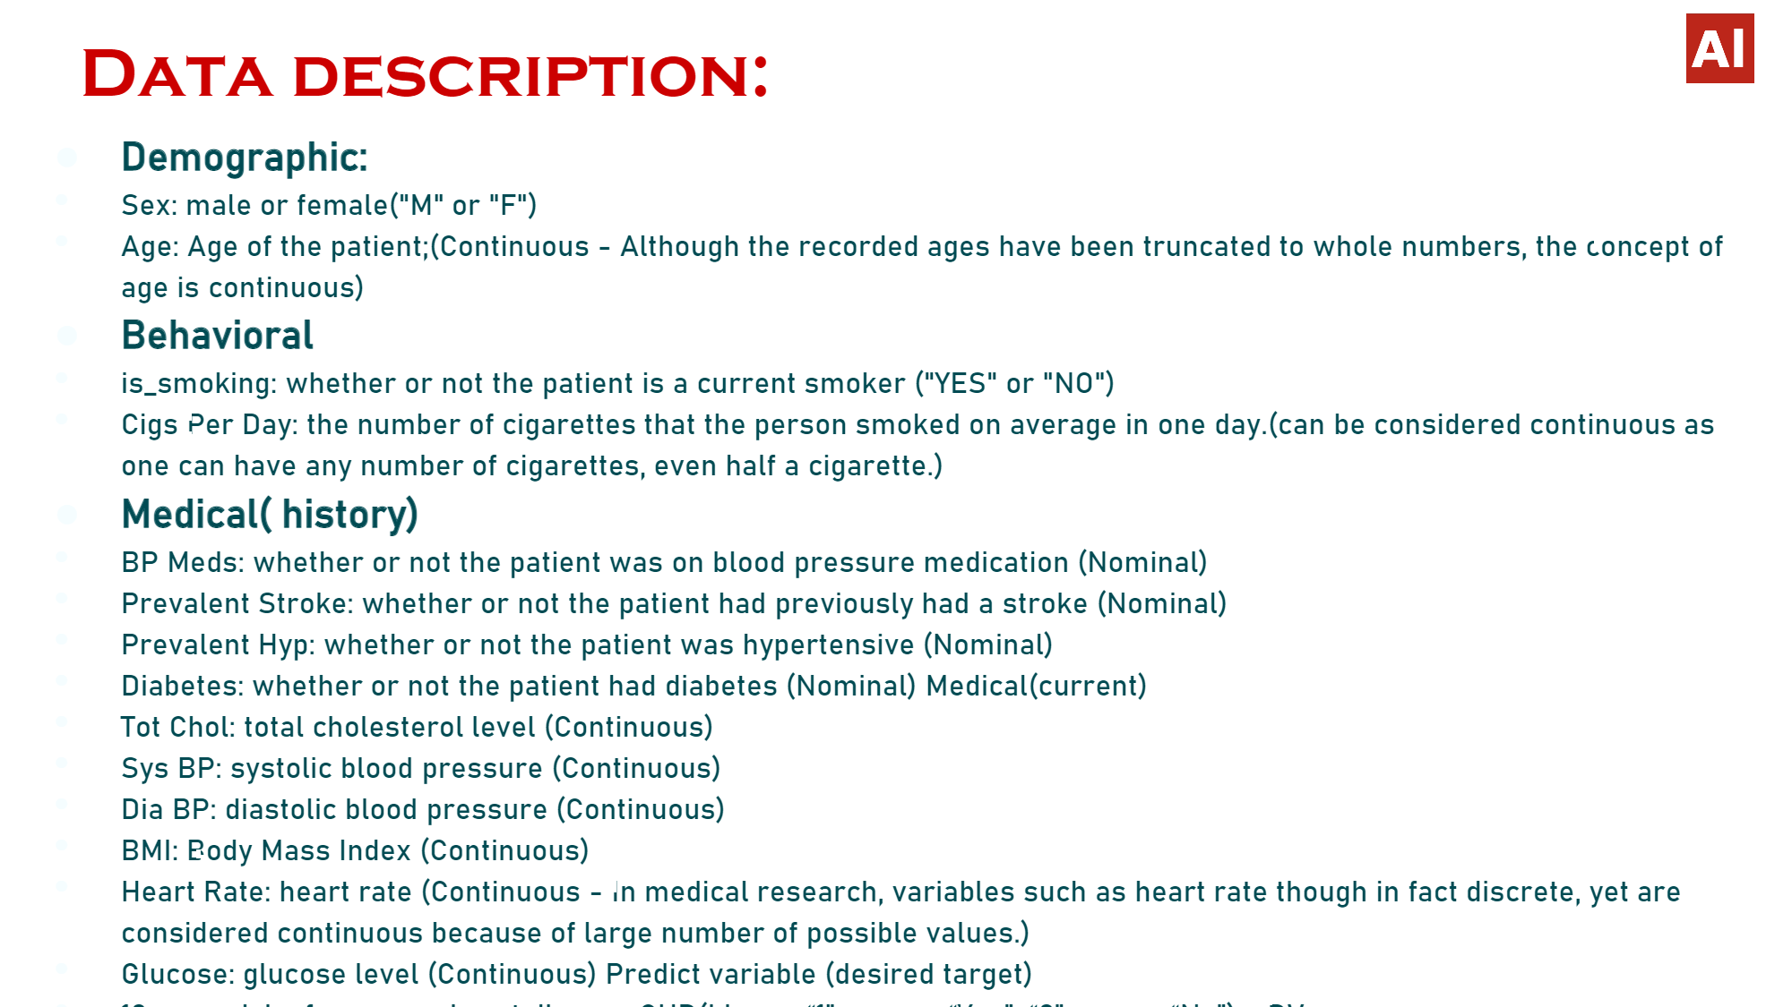

Slide 4
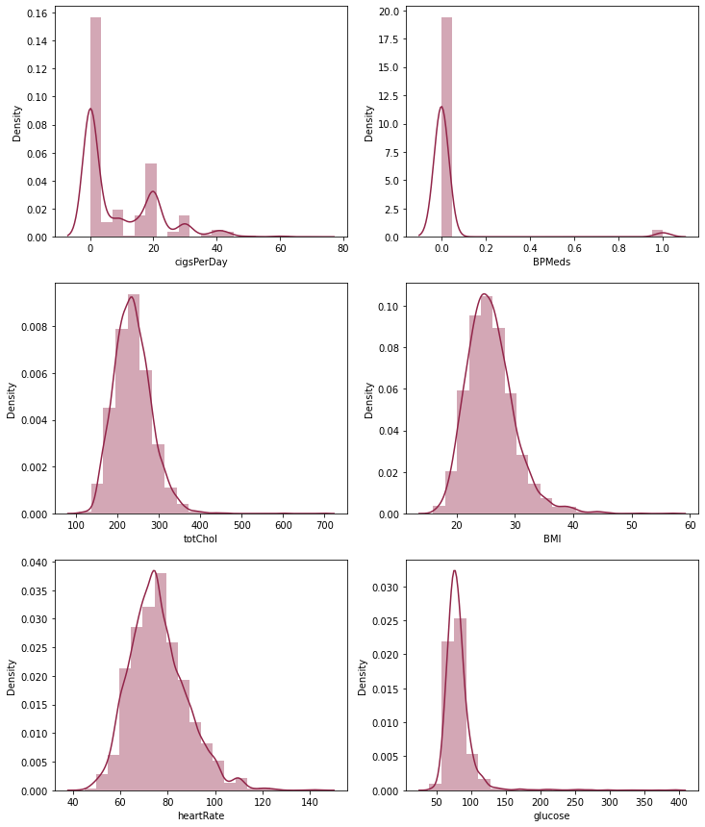
Plotting the distribution plot for those columns which have the null values
the skewness of the column cigsPerDay is: 1.2230053709053774
the skewness of the column BPMeds is: 5.524325007968017
the skewness of the column totChol is: 0.9406357047700903
the skewness of the column BMI is: 1.0222520011438563
the skewness of the column heartRate is: 0.6764897223370003
the skewness of the column glucose is: 6.1443896544049394
Skewness is used to measure the level of asymmetry in our graph. It is the measure of asymmetry that occurs when our data deviates from the norm.
If skewness value is between:
-0.5 and 0.5, the distribution of the value is almost symmetrical
-1 and -0.5, the data is negatively skewed, and if it is between 0.5 to 1, the data is positively skewed. The skewness is moderate, If the skewness is lower than -1 (negatively skewed) or greater than 1 (positively skewed), the data is highly skewed.

Slide 5
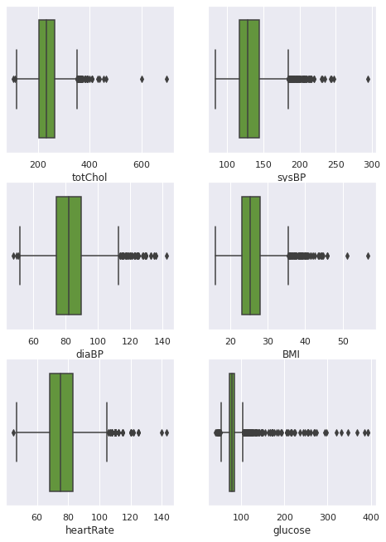
Plotting the boxplot for those columns which have continuous values indicating the outliers:- We can clearly observe from the boxplot that glucose have maximum number of outliers indicating large value of skewness, also heartRate has less number of outliers indicating less value of skewness.
the skewness of the column cigsPerDay is: 1.2230053709053774
the skewness of the column BPMeds is: 5.524325007968017
the skewness of the column totChol is: 0.9406357047700903
the skewness of the column BMI is: 1.0222520011438563
the skewness of the column heartRate is: 0.6764897223370003
the skewness of the column glucose is: 6.1443896544049394
W

Slide 6
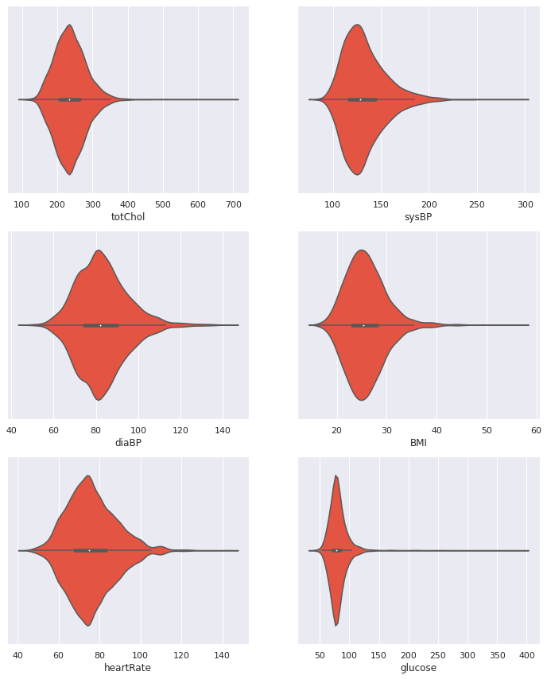
ViolinPlot
In general, violin plots are a method of plotting numeric data and can be considered a combination of the box plot with a kernel density plot.
In the violin plot, we can find the same information as in the box plots:
median (a white dot on the violin plot)
interquartile range (the black bar in the center of violin)
the lower/upper adjacent values (the black lines stretched from the bar) — defined as first quartile — 1.5 IQR and third quartile + 1.5 IQR, respectively.
These values can be used in a simple outlier detection technique (Tukey’s fences) — observations lying outside of these “fences” can be considered outliers.
The unquestionable advantage of the violin plot over the box plot is that aside from showing the abovementioned statistics it also shows the entire distribution of the data. This is of interest, especially when dealing with multimodal data, i.e., a distribution with more than one peak.

Slide 7
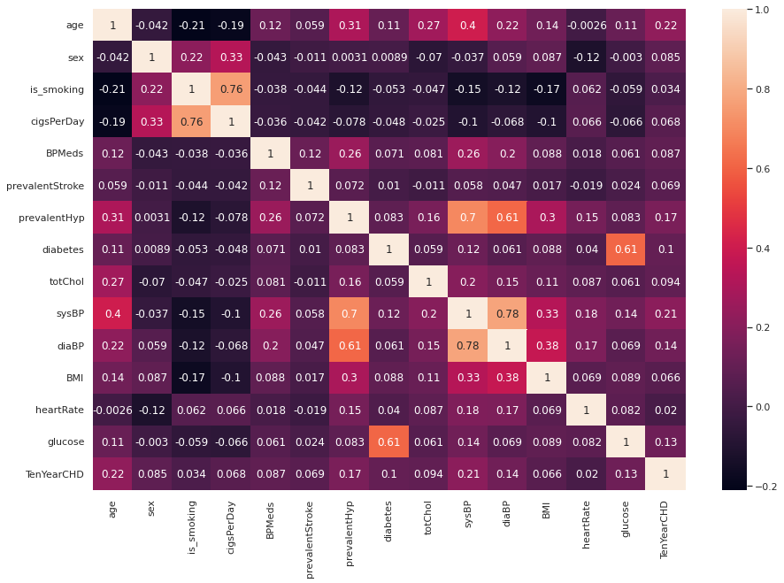
Plotting heatmap to observe the correlation between independent variables:-
Conclusion from Heatmap:-
1.sysBP and diaBP is positively correlated
Systolic Blood Pressure. The normal range of systolic blood pressure should be 90 – 120 mm Hg.
Diastolic Blood Pressure. The normal range of diastolic blood pressure should be 60 – 80 mm Hg.
IF The systolic pressure is high The diastolic pressure should be low.
2.Glucose and diabetes are positively correlated.
Diabetes is a disease that occurs when your blood glucose, also called blood sugar, is too high.
3.is_smoking and age is negatively correlated
indicating older age People have less habit of smoking.
4.prevalentHyp and sysBP is positively correlated.

Slide 8
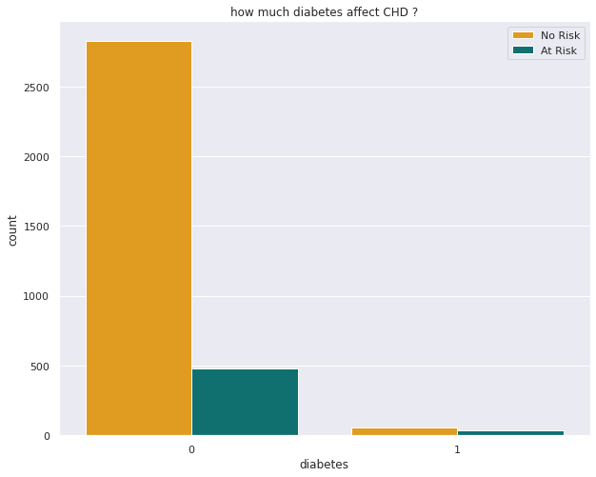
Counting the no. of people whether they are at risk of CHD or not given that they are diabetic or not.
From the above plot it can be interpreted that non-diabetic person is less prone to CHD although there are about 500 people who are non-diabetic but are at risk of CHD indicating the effect of some other factors.
‘0’=nondiabetic
‘1’=diabetic

Slide 9
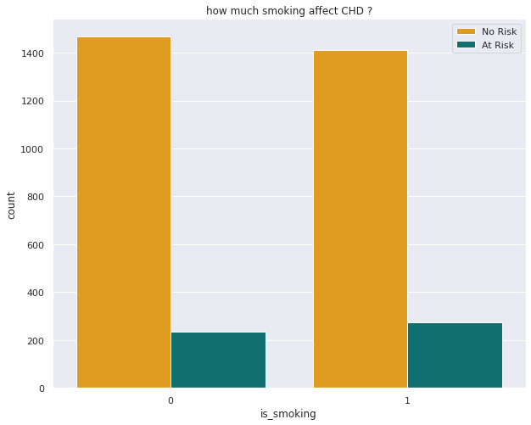
Counting the no of people who is at risk of CHD who is smoking and those who are not smoking.
000
00
Those people who smoke and those who don't smoke are equally at high risk of heart disease. About 200 people are at risk of heart disease who don't smoke and about 300 people are at risk of heart disease who smoke.
‘0’=no smoking
‘1’=yes smoking

Slide 10
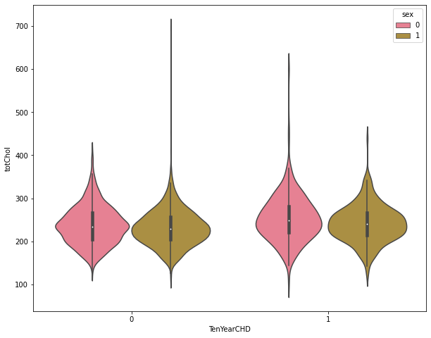
Plotting violin plot to detect total cholesterol of male(1) and female(0) having CHD or not The male has higher density in both cases. As the violin plot is wider for male.
The quartile and whisker values from the boxplot are shown inside the violin. As the violin plot uses KDE, the wider portion indicates the higher density and narrow regions lower density.
The above plot shows the distribution plot of TOTAL CHOLESTRAL of both male(1) and female(0) for those who are at low risk of CHD(0) and high risk of CHD(1).

Slide 11
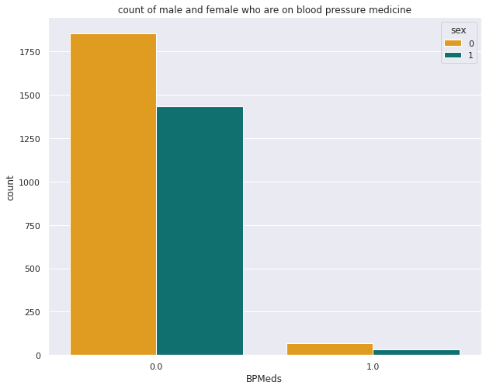
Counting the no of male and female who are on BP medicine Most of the males and females are not using BPMeds. Females are more than males using BPMeds
MM

Slide 12
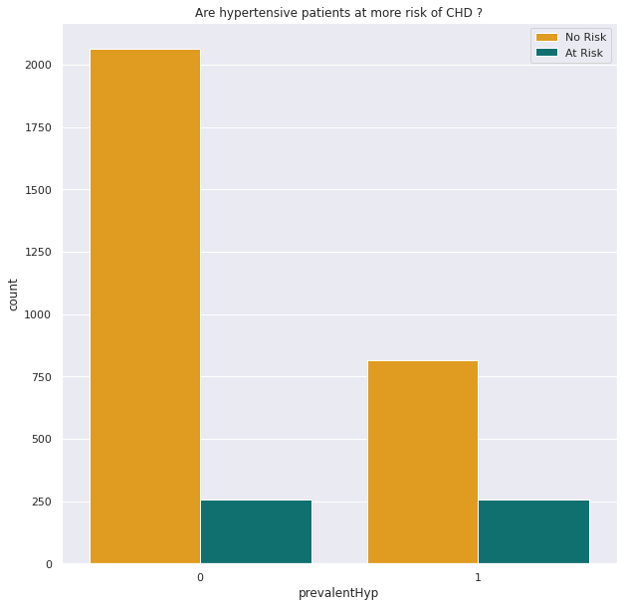
Checking the count of people with hypertensive and whether they are at risk of heart disease or not. From the above plot it can be concluded that there are more no. of people with no prevalentHyp and are low risk to heart disease.
FF

Slide 13
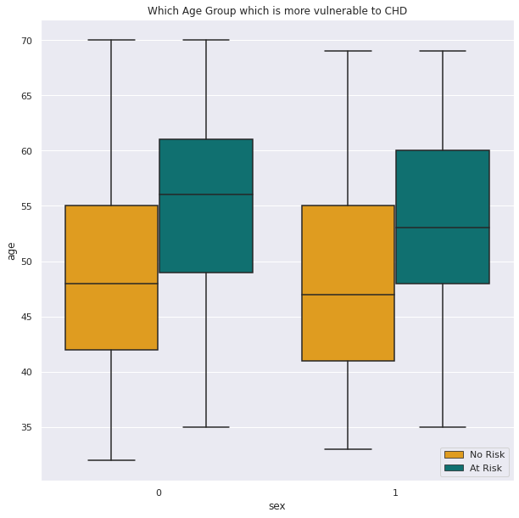
Which Age group is more vulnerable to coronary heart disease ? It can be clearly seen that for both male and female the age group of 50-60 is more vulnerable to heart disease.0 represents female and 1 represents male.

Slide 14
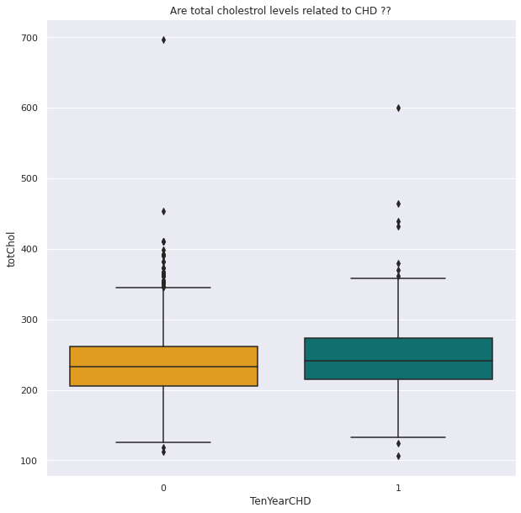
Are Total Cholesterol levels related to coronary heart disease ?? This indicates that cholesterol level is not the sole deciding factor for predicting whether the person gets coronary heart disease or not. People with similar levels of cholesterol have got coronary heart disease as well as are free from coronary heart disease. Clearly, there is no direct correlation of coronary heart disease with the cholesterol level.

Slide 15
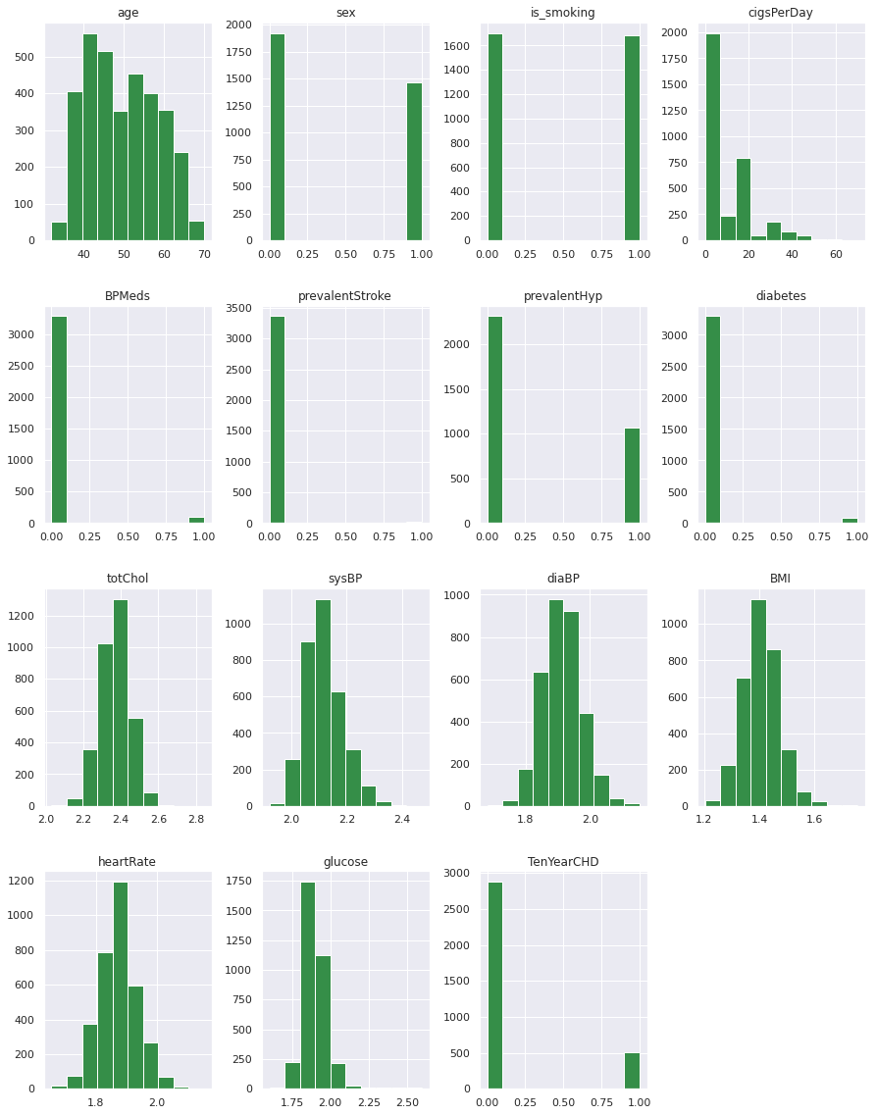
Plot histogram to see the distribution of the data. From the above distribution plot, it can be observed that there are some columns which are not good indicator of CHD as they have imbalanced data like 'BPMeds', 'prevalentStroke' , 'diabetes'...so its better to drop these columns.

Slide 16
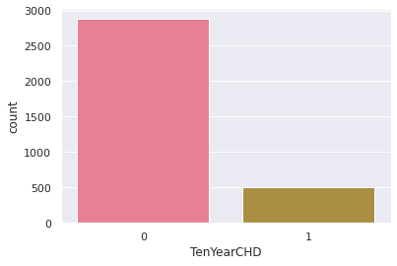
Checking imbalance in the dataset of target variable. Count plot for those who are prone to CHD and for those who are not prone to CHD. It can be clearly observed that the class is imbalance which is going to affect our model, so, before training our model we must balance the class using Smote.

Slide 17
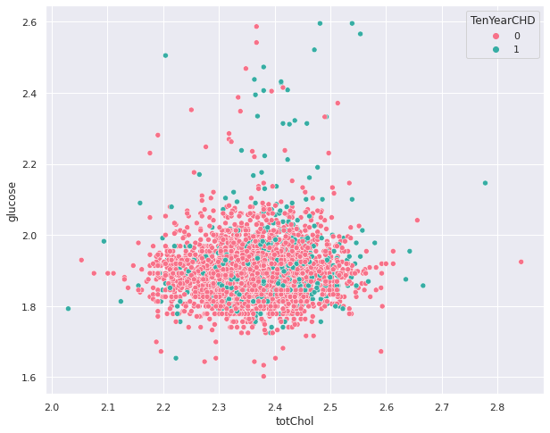
Scatterplot to show the imbalance in the target variable. We can clearly see that the 0 datapoint of TenYearCHD is dominating over 1 hence we must resample this through SMOTE.

Slide 18
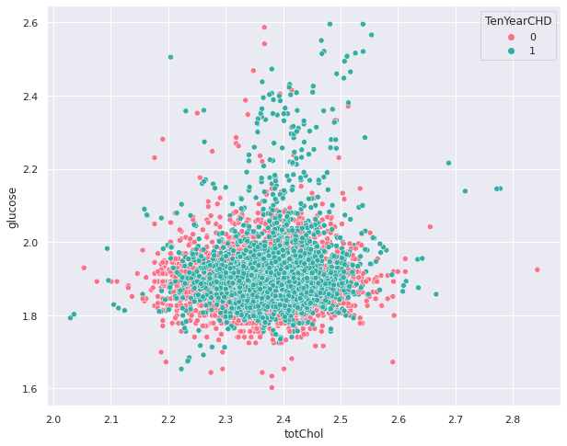
Scatterplot to show that the datasets has been balanced after resampling through smote. SMOTE works by utilizing a k-nearest neighbor algorithm to create synthetic data. Now the class is balanced.

Slide 19
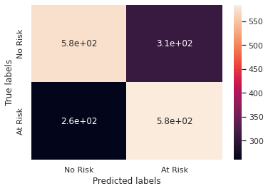
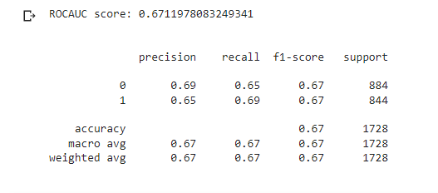
Applying Logistic Regression
logit.coef_= array([[ 0.50555513, -0.04401567, -0.0946658 , 0.43203423, - 0.29275793, 0.10297557, 0.5563105 , 0.04949787, 0.04418578, - 0.08381738, 0.18737959]])
logit.intercept_= array([0.02639605])
The accuracy on train data is 0.6595533498759305
The accuracy on test data is 0.6707175925925926
logit.get_params()=
{'C': 1.0, 'class_weight': None,
'dual': False,
'fit_intercept': True,
'intercept_scaling': 1,
'l1_ratio': None,
'max_iter': 10000,
'multi_class': 'auto’,
'n_jobs': None,
'penalty': 'l2’,
'random_state': None,
'solver': 'lbfgs’,
'tol': 0.0001, 'verbose': 0,
'warm_start': False}

Slide 20
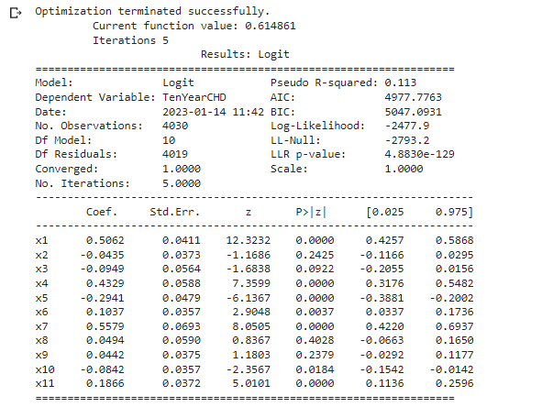
Stats models provides a Logit() function for performing logistic regression. The Logit() function accepts y and X as parameters and returns the Logit object. The model is then fitted to the data.

Slide 21
Accuracy Score for different ML algorithms. 1.Logistic Regression:- 8.KNN Classifier:- Accuracy Score for train Datasets:- 0.6595533498759305 Accuracy Score for train Datasets:-0.82 Accuracy Score for test Datasets:- 0.6707175925925926 Accuracy Score for test Datasets:-0.73 2.Logistic Regression with Hyperparameter tuning:- Accuracy Score for train Datasets:- 0.6401985111662531 Accuracy Score for test Datasets:- 0.6197916666666666 3.Decision Tree:- Accuracy Score for train Datasets:- 0.6930521091811415 Accuracy Score for test Datasets:- 0.6290509259259259 4. Decision Tree with Hyperparameter tuning:- Accuracy Score for train Datasets:- 0.896029776674938 Accuracy Score for test Datasets:- 0.7210648148148148 5. Random Forest Classifier:- Accuracy Score for train Datasets:- 1.0 Accuracy Score for test Datasets:- 0.8431712962962963 6. AdaBoost:- Accuracy Score for train Datasets:- 0.6990740740740741 Accuracy Score for test Datasets:- 0.7429280397022332 7. XGBoost:- Accuracy Score for train Datasets:- 0.8267990074441688 Accuracy Score for test Datasets:- 0.7662037037037037

Slide 22
Findings and Applications
1.The elderly are more likely to suffer from various types of cardiovascular diseases.
2.Cholesterol level is a very important determinant in leading to cardiovascular diseases. The risks of getting cardiovascular diseases climb significantly when the cholesterol content in human body rises above the normal.
3.People with high alcohol consumption have a lower likelihood to have cardiovascular diseases.
4.Physical activities help people become less susceptible to cardiovascular diseases.
5.A female non-smoker is less likely to have cardiovascular diseases, while a male smoker is less likely to get cardiovascular diseases.
6.If people have systolic blood pressure ≥ 126, they are classified as those susceptible to cardiovascular diseases. Therefore, high systolic blood pressure plays an important role in predicting that one experiences greater risks of suffering from cardiovascular diseases.
7.Among the three splitting factors, two of them are age. This suggests that apart from systolic blood pressure, age is the second most significant factor in deciding whether a person will have a chance of getting cardiovascular disease.

Slide 23
CONCLUSION:-
1.As age increases the risk of getting diagnosed with heart disease also increases.
2.Cigarette consumption is also a major factor that causes CHDs.
3.Patients having Diabetes and cholesterol problems show a higher risk of CHDs.
4.Patients having high glucose levels are more prone to CHDs.
5.Patients with a history of “strokes” have a higher chance of developing CHDs.
6.Patients with high BMI(Body Mass Index) are at more risk of getting diagnosed with CHDs.
7.Finally we can say that XGBoost Classifier has performed best among all the models with the accuracy of 76% & f1-score of 0.71. It is by far the second highest score we have achieved. So, It's safe to say that XGBoost Classifier provides an optimal solution to our problem.

